Slide 1

BG30 ERP: Transforming Construction Materials Management

Slide 2
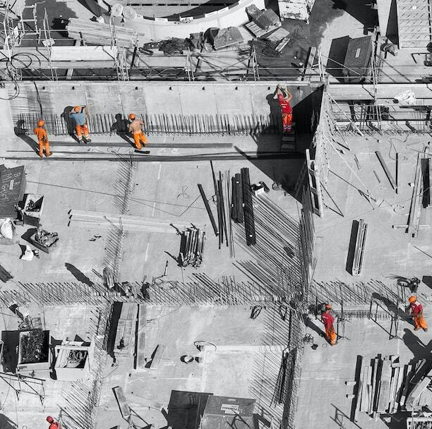
BG30 ERP: Transforming Construction Materials Management
Introduction
Industry Challenge: Construction projects often suffer from material shortages, mismanagement, and overstocking, leading to costly delays and inefficiencies.
ERP to the Rescue: BG30 ERP is tailored to streamline materials handling, automate procurement, and track inventory in real-time.
Why It Matters: Efficient materials management saves up to 25% of total project costs and accelerates completion timelines.
Notes:
Managing construction materials has always been one of the most daunting tasks in the industry. From miscommunication to miscalculations, inefficiencies often snowball into costly delays. Our solution, BG30 ERP, is built specifically for construction firms to take the chaos out of material management. This system automates the core tasks: tracking what materials are where, what needs to be ordered, and when. It's about working smarter, not harder. With BG30, even small projects can gain the efficiency of megaproject operations. Think of it as the heartbeat of your construction supply chain—making sure every piece is where it should be, when it should be, without wasting a dime.

Slide 3
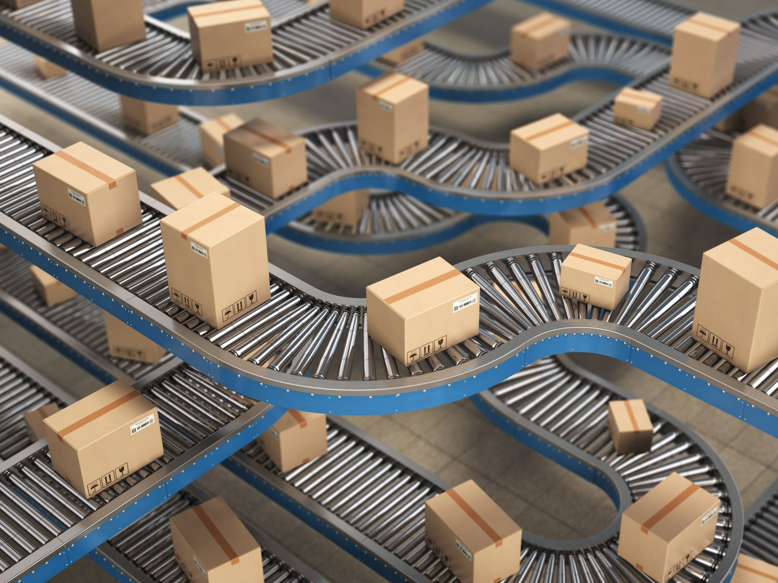
Core Features of BG30 ERP
Optimized for Construction Material Management
Real-Time Inventory
Track material availability and movement across multiple project sites instantly.
Automated Procurement
Generate and manage purchase orders automatically based on inventory thresholds.
Supplier Performance Insights
Evaluate suppliers based on delivery reliability, cost, and quality metrics.
Cost Integration
Sync material costs with project budgets to maintain financial control.
Notes:
BG30 ERP is more than just software—it's your digital site manager. At its core are features that simplify and centralize construction material management. Real-time inventory ensures you're never short or overstocked. The automated procurement engine triggers purchase orders the moment you need to restock. No more guessing, no more downtime. The system also provides supplier scorecards, giving you a complete view of who's reliable and who's not. Lastly, cost tracking tools help tie material spending directly to budgets—keeping your financials as tight as your build schedules.

Slide 4
Benefits of Using BG30 ERP
Efficiency, Cost-Saving, and Clarity
Cost Reduction
Reduce material wastage and project delays, saving up to 25% in overall costs.
Workflow Efficiency
Automate manual processes to free up management time and avoid human errors.
Real-Time Decisions
Make informed decisions faster with centralized data dashboards.
Scalability
Easily adapt the system to manage projects of various sizes and complexity.
Notes:
The benefits of BG30 ERP are felt from day one. For starters, project managers report up to 25% reduction in costs—thanks to real-time visibility and tighter inventory control. With automated workflows, teams spend less time on routine tasks and more on strategic execution. Plus, with all your data in one place, decision-making becomes swift and evidence-based. You’ll never wonder where your materials are or what’s overdue. Perhaps most importantly, this system grows with your business. Whether you're building a single home or managing multiple commercial projects, BG30 ERP is designed to scale effortlessly.

Slide 5
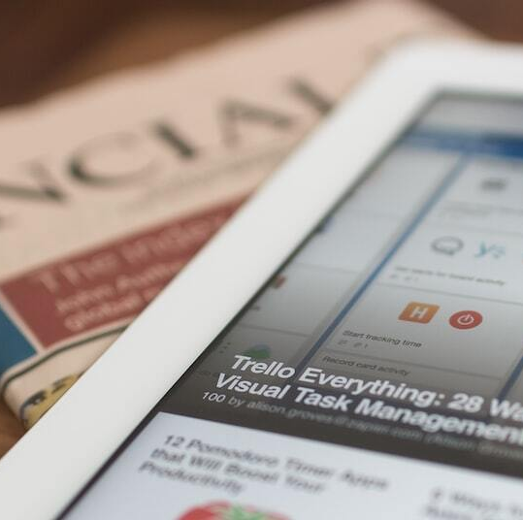
Emerging Trends in Construction ERP
Driving Digital Transformation
Cloud ERP: Over 70% of new ERP deployments in construction are cloud-based, enabling access from anywhere.
Mobile Accessibility: Field teams use tablets and phones to update material status in real time.
Sustainability Tracking: ERP systems now include tools to monitor material carbon footprint and waste.
Notes:
The construction industry is quickly evolving with digital technologies—and ERP systems are at the forefront of this shift. Cloud-based systems now dominate the market, giving teams the freedom to access project data from anywhere, whether on-site or in the office. Mobile accessibility has become essential. Tablets and smartphones aren't just convenient—they're game-changers, allowing real-time data updates and approvals in the field. And with the rise of IoT, materials can be tracked using sensors, automatically updating inventory without manual entries. Another big push is toward sustainability. Modern ERP solutions like BG30 integrate environmental metrics, helping companies monitor and reduce their carbon footprint—a growing priority in global construction.

Slide 6
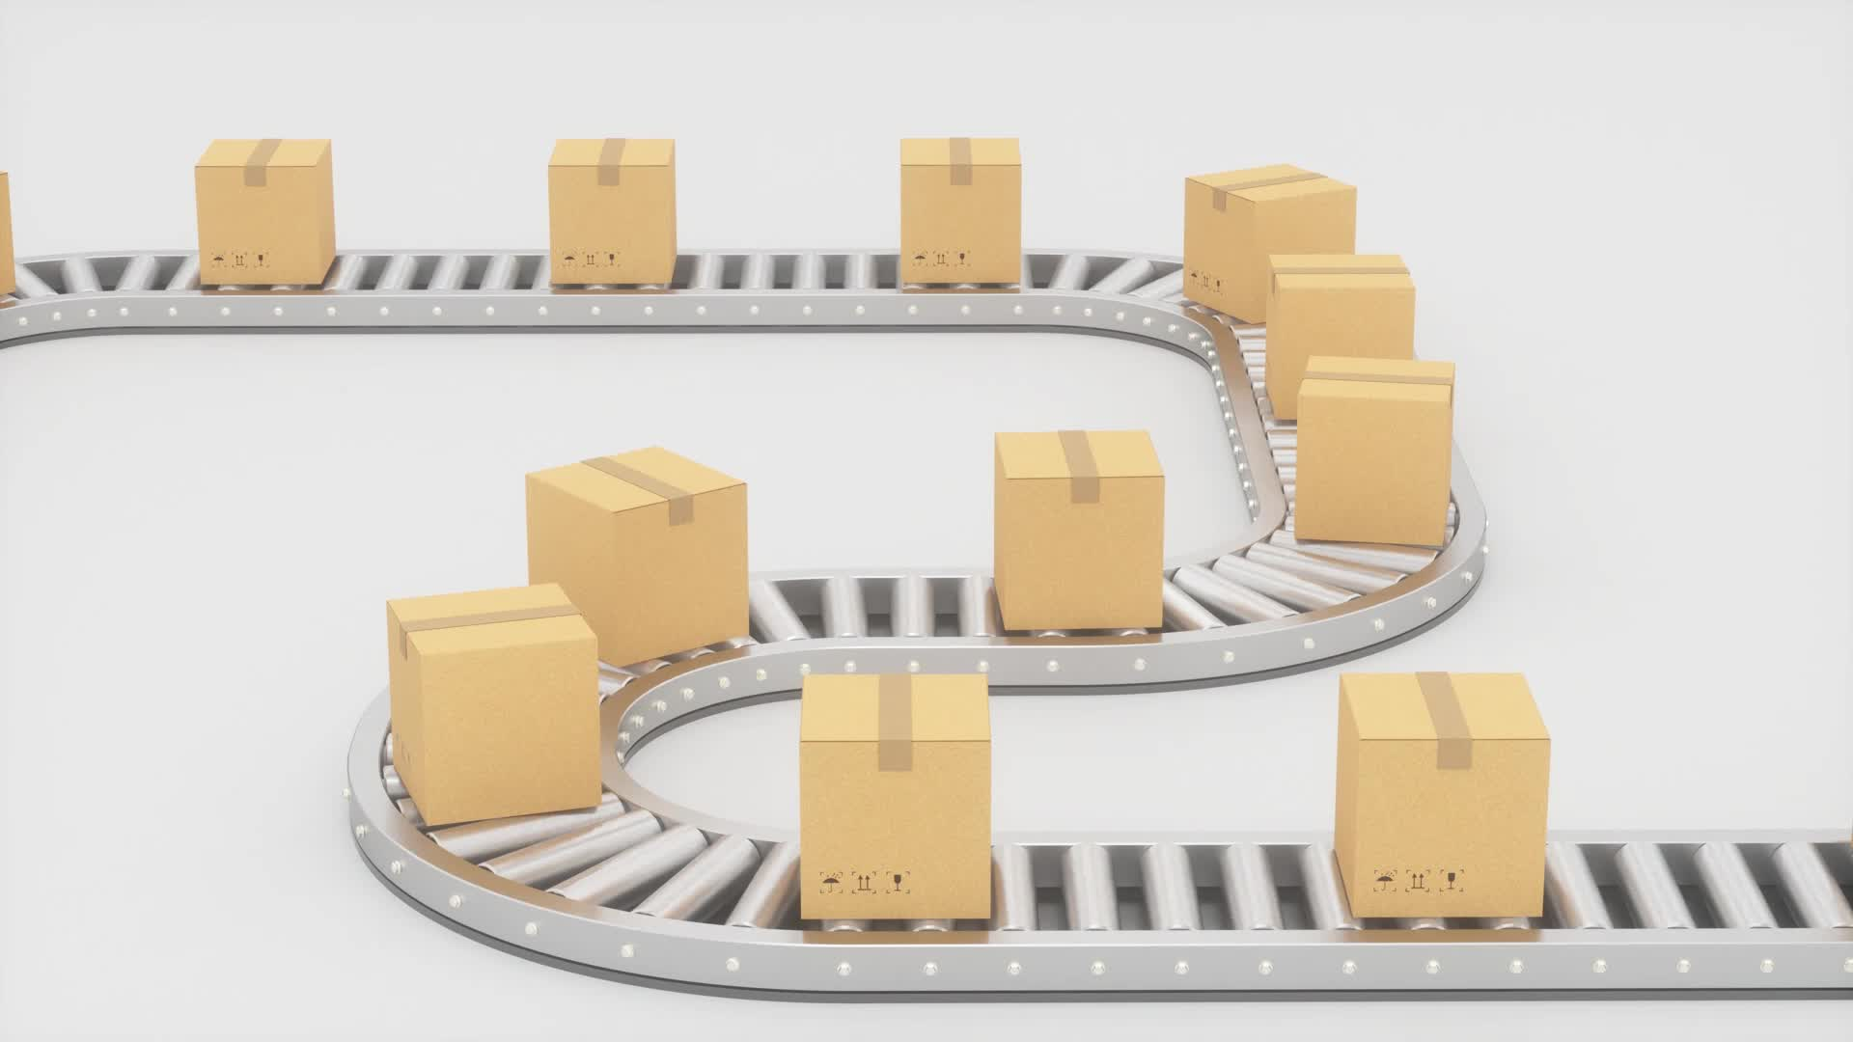
Expected Impact of BG30 ERP
Efficiency Gains
Expected 30% faster material ordering and reduced stockouts.
Cost Savings
Expected up to 20–25% reduction in material wastage across pilot projects.
Faster Project Completion
ERP users shall complete builds 15% quicker due to streamlined logistics.
Increased Transparency
Centralized dashboards will improve visibility across teams and stakeholders.
Notes:
Pilot deployments of BG30 ERP have shown significant impacts. On average, construction firms reported material ordering times cut by 30%, reducing project delays due to shortages. More impressively, there was a 20–25% reduction in material waste. This not only translates into direct cost savings but also reduces environmental impact—a win-win. Additionally, ERP users completed projects 15% faster thanks to improved coordination and logistics. Another game-changer was the introduction of centralized dashboards, making it easier for managers and stakeholders to track progress, budget adherence, and material movement in real time.

Slide 7
Conclusion & Roadmap
BG30 ERP in the Future of Construction
Digital Transformation
BG30 ERP is central to digitizing materials management in construction.
Scalable Framework
Adapts to both small projects and large-scale infrastructure developments.
Data-Driven Decisions
Future versions will integrate AI for predictive logistics and budgeting.
Sustainability Commitment
Expanding eco-tracking features to meet growing green building standards.
Notes:
To wrap it all up—BG30 ERP is more than a tool; it’s a cornerstone of digital transformation in construction. Whether you’re managing a residential build or a complex commercial project, it scales and flexes to your needs. Looking ahead, the roadmap includes AI-powered features for predictive procurement, smarter budgeting, and sustainability metrics that align with future green regulations. It’s a future-focused platform that evolves with the industry. As construction becomes more complex, tools like BG30 ERP will ensure your operations remain agile, efficient, and ahead of the curve.

Slide 8
BG30 ERP Recap
Key Takeaways at a Glance
Tailored for Construction
Designed to solve material management inefficiencies unique to construction projects.
Automation & Analytics
Automates procurement, tracking, and reporting with real-time dashboards.
Anticipated Results
Adopters will achieve up to 25% cost savings and 15% faster project completion.
Future Ready
Roadmap includes AI, IoT, and sustainability metrics to future-proof operations.
Notes:
Let’s summarize what makes BG30 ERP a game-changer in construction materials management. It’s tailor-made for the construction industry, solving longstanding pain points with efficiency and clarity. From automating procurement and tracking to delivering real-time insights, it reshapes the way projects are executed. The results speak for themselves—early users saw major gains in cost control and speed. And it doesn’t stop there. With AI, IoT, and sustainability on the horizon, BG30 ERP is built not just for today, but for the construction needs of tomorrow.

